Slide 1
Lecture 5: Depth Perception
Ground theory
Motion parallax
Translational and rotational flow
FOE for heading specification – prism studies

Slide 2
Optic flow patterns

Slide 3
Distinguishing self motion from object motion

Slide 4
Changes and regularity
Locomotion => optic flow
Stationary => no optic flow
Outflow specifies approach
Inflow specifies retreat
Translation (motion) yields optic flow; optical invariance (FOE, FOC) specifies properties of motion.
Focus of Contraction
Focus of Expansion
(node, where flow = 0)
Perception and perceptual info are time extended: no sensations, no memory required.

Slide 5


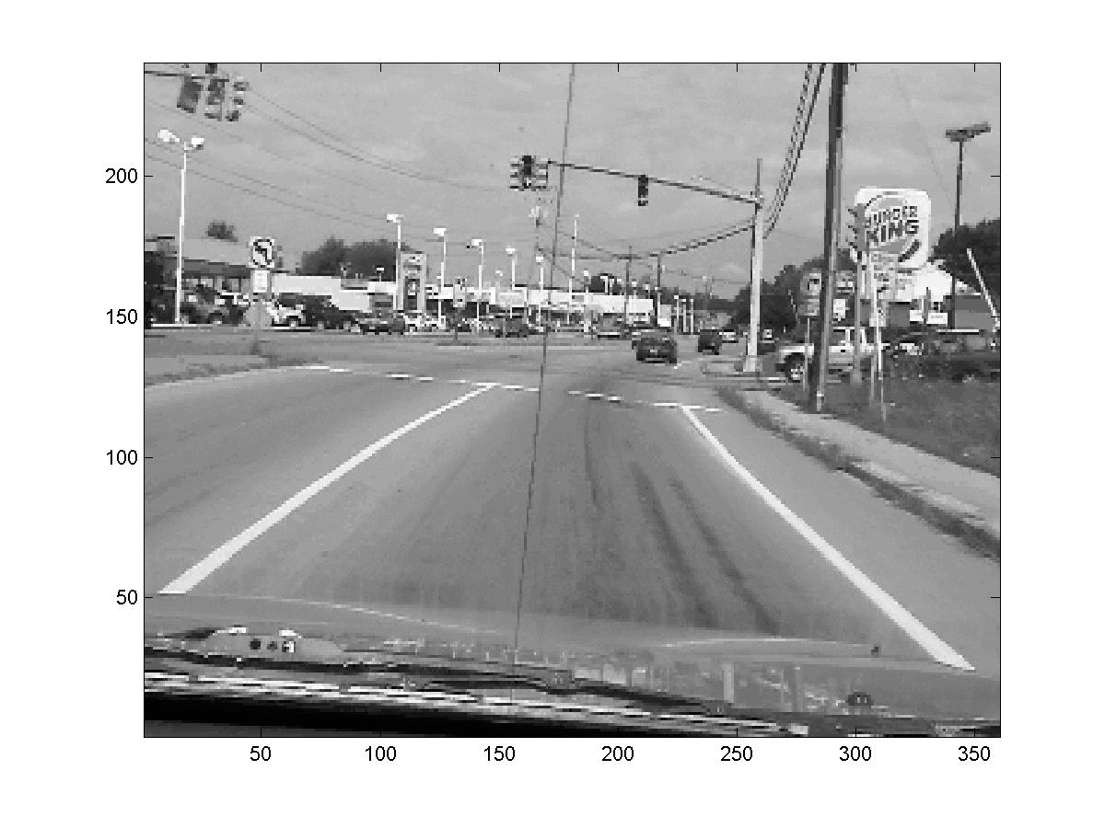
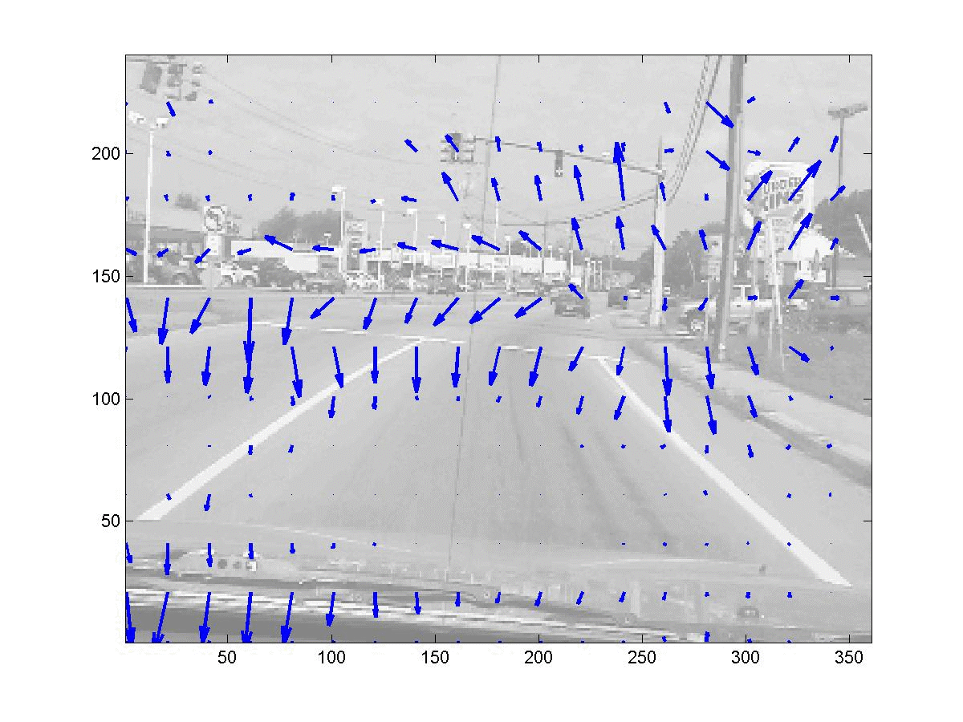
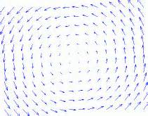
Translational flow vs. rotational flow
Trans flow: when the POO is translating (moving around) in the environment
Rot flow: when the POO is in an eye that rotates

Slide 6
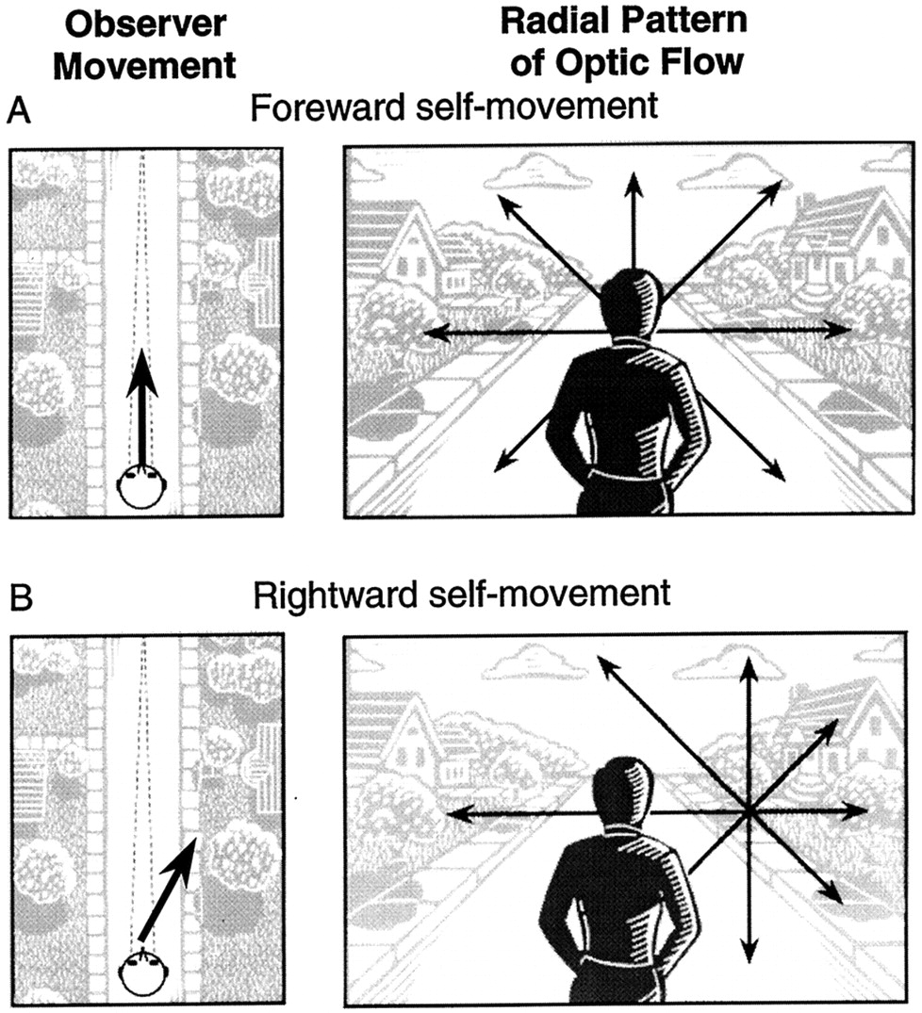
Changes and regularity
Steering rule: move so as to place the FOE inside the visual solid angle projected from the target to be approached
FOE specifies heading direction.
Shift of focus from one VSA to another specifies change of direction of heading ( = steering).

Slide 7
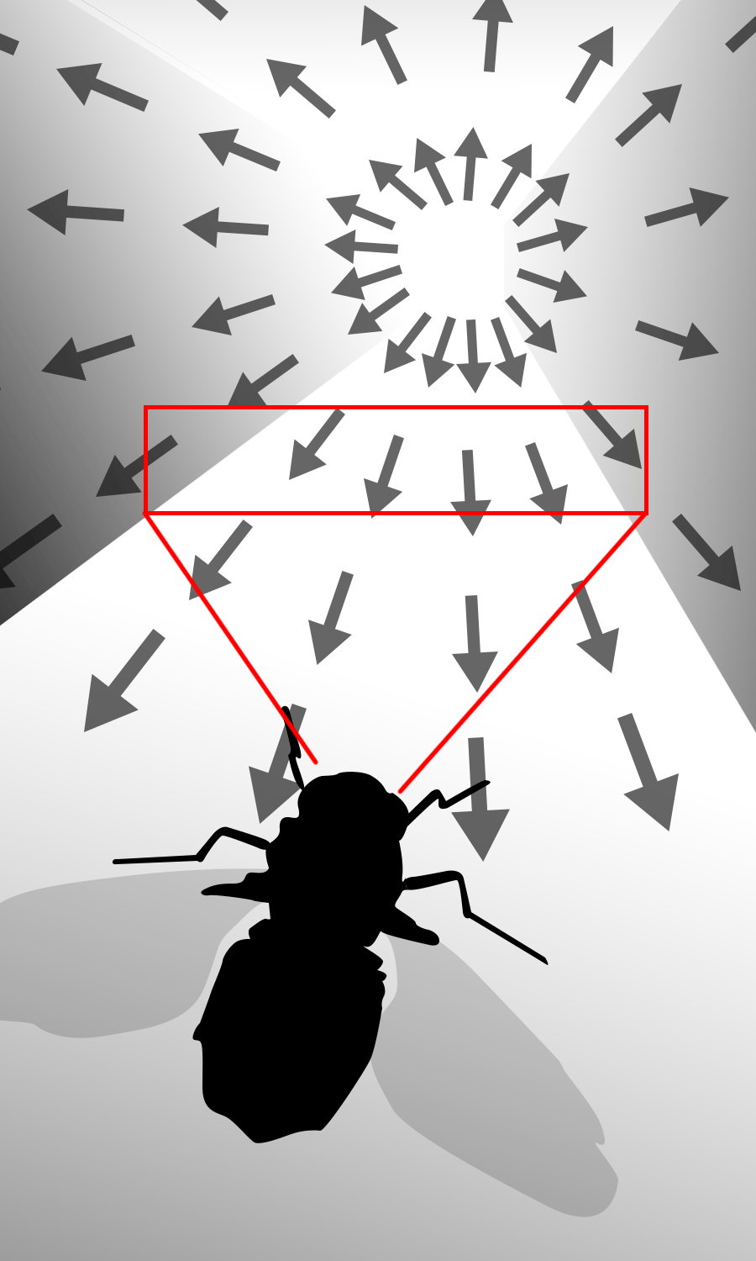
Changes and regularity
FOE specifies heading direction, but the FOE does not have to be in view
The father away from the FOE, the faster the flow speed is (0 flow at the FOE.)
Can detect the FOE by detecting the flow patterns. The more the optic array is sampled, the better the perceived 3D structure. (Looking though a slit vs. IMAX. )

Slide 8
Perception is spatial-temporal
Michotte (1946): The perception of causality

Slide 9
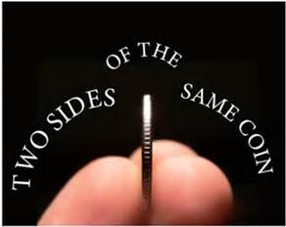
Four pillars of ecological approach
Perception can only be understood in relation to environment (A-E mutuality)
Animal is adapted to regularities of the econiche that support perception/action
Physical and informational regularities, ecological constrains
Perception is evolved to guide actions (functional)
Adapt to information that supports successful action
Semantics (= meaning) grounded in action
Perception/action coupling
Information as specificity
Higher-order spatiotemporal patterns of stimulation
Specific to behaviorally-relevant properties, within eco context of constraints
Perception as the detection of information by an attuned perceptual system
Implicit mapping from information to behaviorally-relevant properties
Attunement in evolution and learning

Slide 10
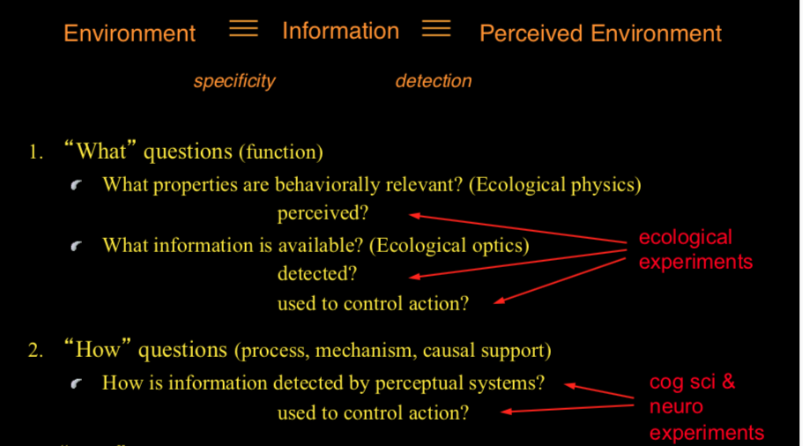

Slide 11
Occlusion and depth order

Slide 12



Slide 16
The case of progressive occlusion
Occlusion: light pattern corresponding to the surface of the ball goes out of existence in the optics. But, is (the surface of) the ball going out of existence in the world?
When surfaces in the world:
Going out of sight:
Deletion of optical texture at an edge.
Reversible (coming into sight, with accretion of optical texture at an edge).
Going out of existence:
Melting, evaporating, exploding, burning, crushing…
Irreversible.

Slide 18
Front surface moving
Deletion of texture elements on the front moving edge (wrt moving dir); accretion of texture elements on the rear moving edge.
Back surface moving
Accretion of texture elements on the front moving edge (wrt moving dir); deletion of texture elements on the rear moving edge.

Slide 19


back continuous

Slide 20
front continuous

Slide 21
Static

Slide 22
Back move

Slide 23
front move

Slide 24
Font surface stripes… rear surface dots…when approaching, deletion of dots by stripes
How about retreating from an obstacle?
Font surface stripes… rear surface dots…when approaching an aperture, accretion of dots on the inside edges of striped area
How about retreating from an aperture?

Slide 25
Depth perception

Slide 26
Depth
Distance to eye
Lost in retinal image → the oldest problem in perception
Constructivism: how does an observer reconstruct depth with 2D retinal image?
Eco: what is the info for depth (such that the observer can detect it directly from optic flow)?

Slide 27
Air theory vs. Ground theory
Linear measures
Angular measures
Notes:
Ground theory

Slide 28
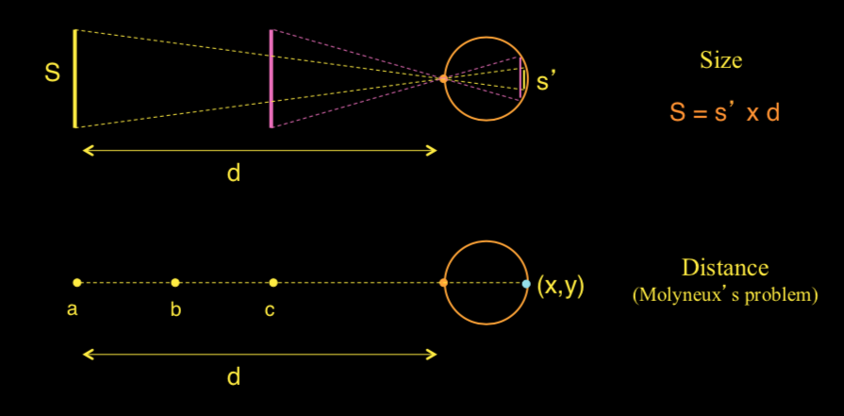
Air theory: perceiving dots in empty space

Slide 29
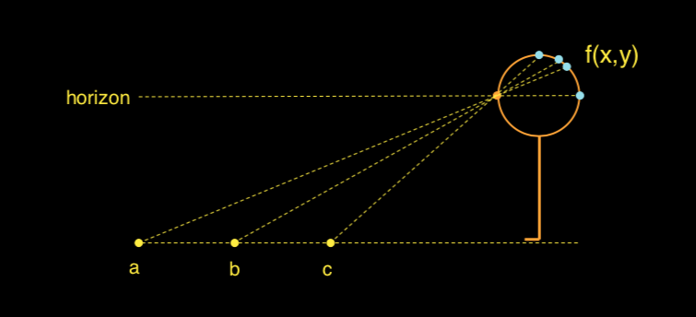
Ground theory: perceiving layout of surfaces

Slide 30
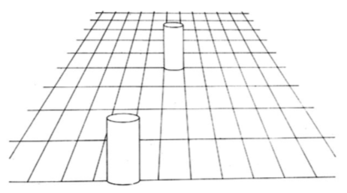
Ground theory: perceiving layout of surfaces
Use ground textures to resolve…
Size: equal size objects cover equal number of textures (do not need to know distance to know size)
Distance: equal distances along the ground span over equal number of textures
Layout of scene: specified by relative positions of objects on the ground surface

Slide 32
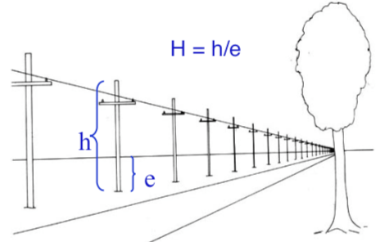
Horizon ratio and size perception
The horizon line intersects objects at eye level. Object size is specified in units of eye height (e ), which is an invariant that allows perceiving size without knowing distance. All objects with the same horizon ratio are of the same height (size constancy). In an open field, size constancy holds up to ~ 800m.

Slide 33
Notes
Distinguish world and optical structure
Study the relation b/w them
Optical structures are not copies of world structures, but they are related (the former specifies the latter)
Static optical texture element gradient specifies slant
Dynamical (change of) optical structure (i.e. optic flow and its changes) specifies motion-related properties, e.g. heading and steering

Slide 34
Translational flow

Slide 35
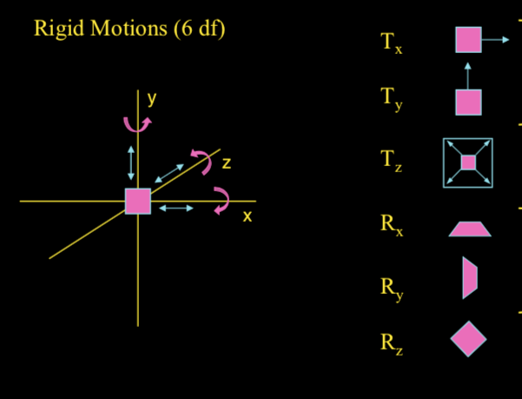
Translation (in the world) yields translational flow or motion parallax (in the optics)
Approaching or retreating yields optical expansion (looming) or contraction
Rotation in depth yields non-rigid optical transformation – structure from motion
Rotation in the frontoparallel plane – rotational flow

Slide 36
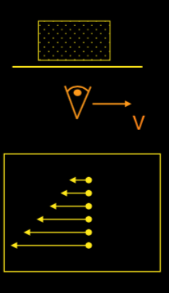
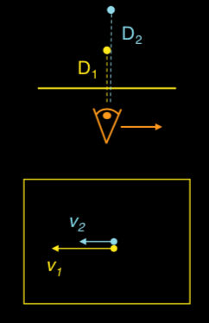
Motion parallax
(Helmholtz)
Motion perspective (over optic flow)
(Gibson)
AIR
GROUND
Points in space
Distance is inversely proportional to optical velocity
Continuous textured surface
Surface layout is specified by gradient of velocities

Slide 37
Motion perspective gradient
In the world, A, B, C and D have the same velocity, -V_{w}. What about in the optics? Are the optical velocities (v_{o}’s) the same for the four objects?

Slide 38
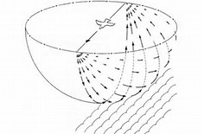
Formal analysis of motion parallax
|V|
D (heading direction)
S
Q (a point in the world)
β
|V|
S
|V|
β
O (observer)

Slide 39
Formal analysis of motion parallax
|V|
D (heading direction)
S
Q (a point in the world)
β
V₁
V₂
β
V
S
-V
v₂ → looming
v₁ → motion parallax
v₁
β
1
O (observer)
Unit circle
Notes:
v2 = A*Vw/(S^2)

Slide 40
Formal analysis of motion parallax
|V|
S
D (heading direction)
β
Q (a point in the world)
β₀
P
β_{Δt}
|V|*Δt
H
S
β₀
α
|V|*t
O (observer)

Slide 41
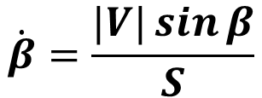
Formal analysis of motion parallax
$$\dot{β}=\frac{|V|\sin{β}}{S}$$

Slide 42
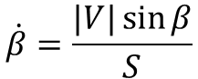
$$\dot{β}=\frac{|V|\sin{β}}{S}$$
Standard motion parallax: β=90°,
|V|
Let |V|=10 m/s
S = 10m, 20m, 30m
β=0°,5°, 10°, 15°, 20°, 80°, 90°
P₁
P₂
P₃
POO
β°
 | 0 | 5 | 10 | 20 | 80 | 90
10 m | 0 | ? | ? | 0.342 | 0.985 | 1.000
20 m | 0 | 0.044 | 0.087 | ? | ? | 0.500
30 m | 0 | 0.029 | 0.058 | 0.114 | 0.328 | 0.333
S

Slide 44
Terms covered
Depth perception: Air theory, ground theory
Motion parallax vs. motion perspective
Translational flow

Slide 45
Reading
Gibson (1979/1986) Chapters 5 & 9

